Slide 1
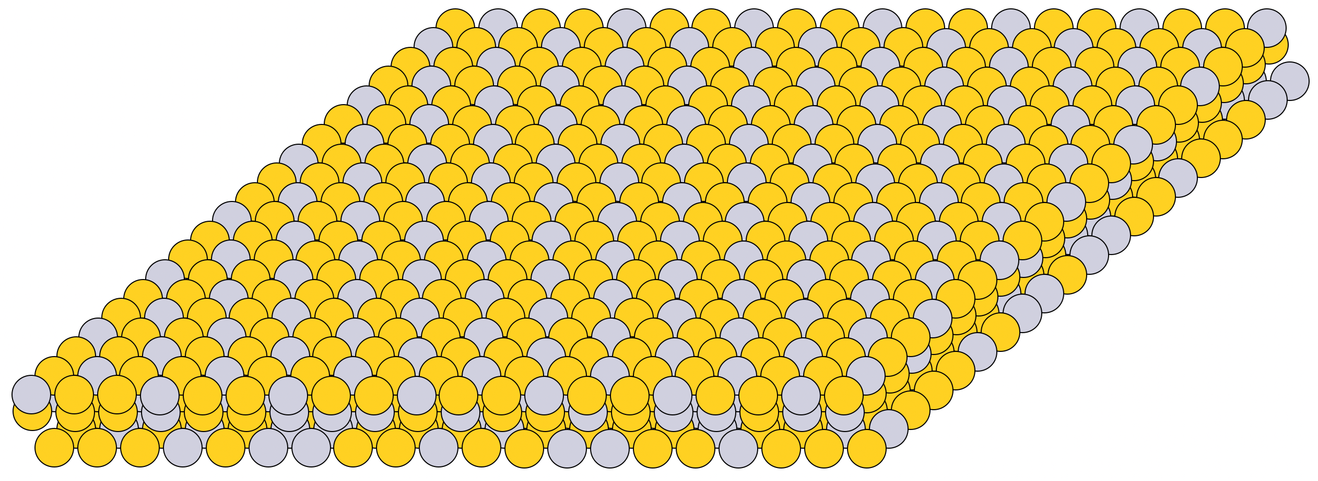
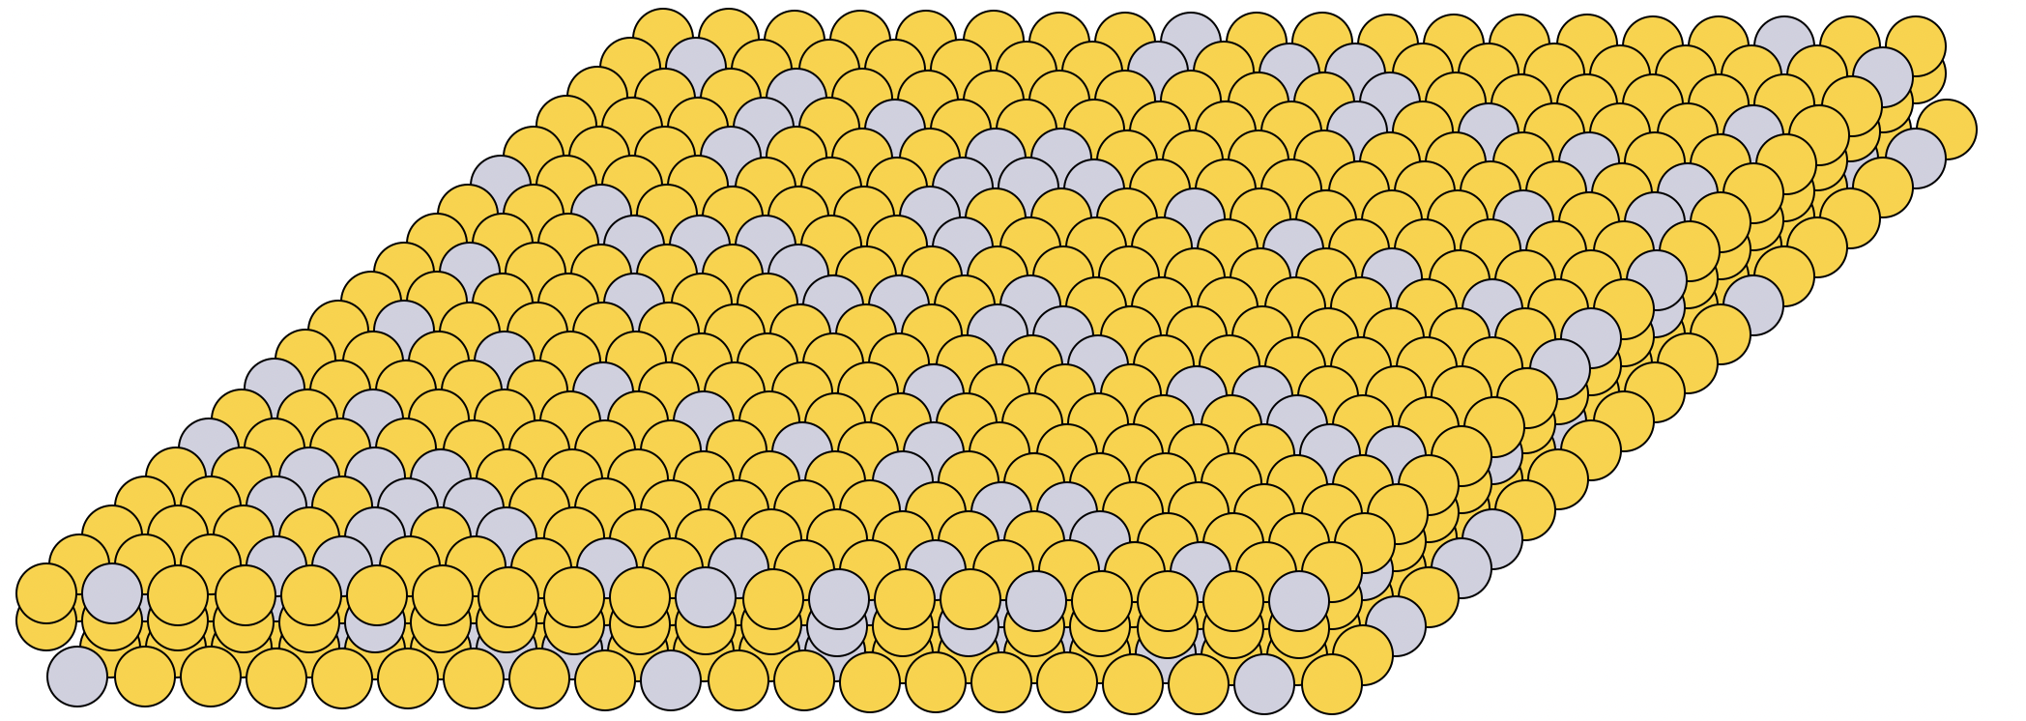
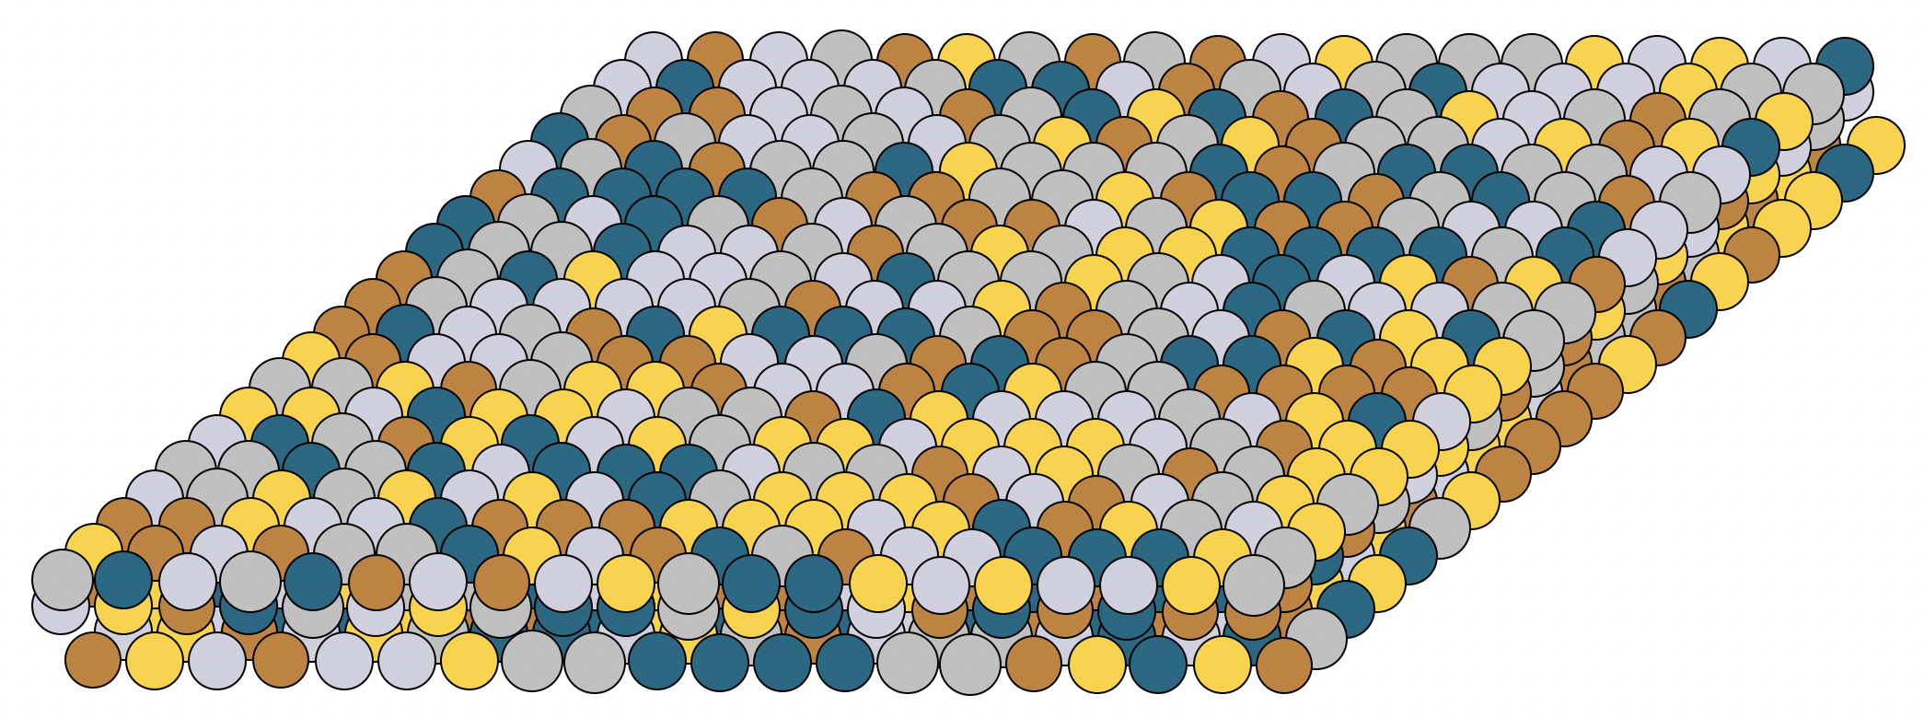




Simulating surfaces
Based on stoichiometry, structure and dimensions
Single-site structure
$$Pt_{0.33}Pd_{0.0}Cu_{0.0}Ag_{0.0}Au_{0.67}$$
Bimetallic alloy
$$Pt_{0.14}Pd_{0.0}Cu_{0.0}Ag_{0.0}Au_{0.86}$$
$Pt_{a}Pd_{b}Cu_{c}Ag_{d}Au_{e}$+structure
High-Entropy Alloy
$$Pt_{0.2}Pd_{0.2}Cu_{0.2}Ag_{0.2}Au_{0.2}$$

